Slide 1
In this dataset the survey was not done properly because the ratio of women is relatively low as compared to men. Most of the employees belong to united states and ratio of males is high. The people who have education more than 12 standard have chances to get more than 50k. Comparing all four charts the people who work as Exec-Mangerial works for more than 40hours and earns more than 50k. If you have your education level more than or equal to high school graduation you have more chances of earning more than 50k. The people who are married-civ-Spouse and works as Exec-managerial have higher percentage of earning more than 50k

Slide 2
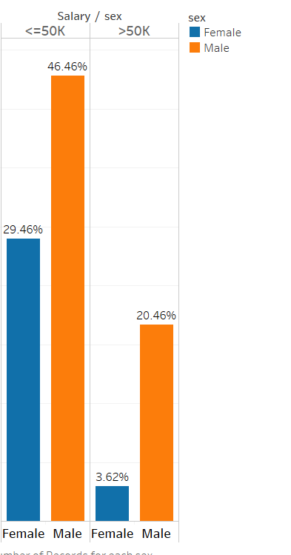
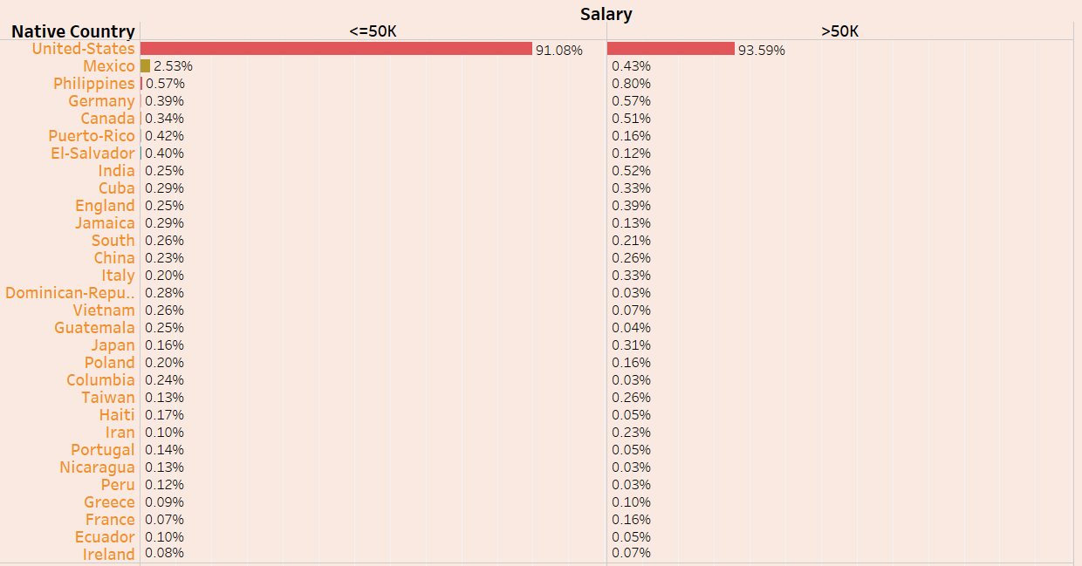
Most of the employees belong to united states and ratio of males is high.

Slide 3
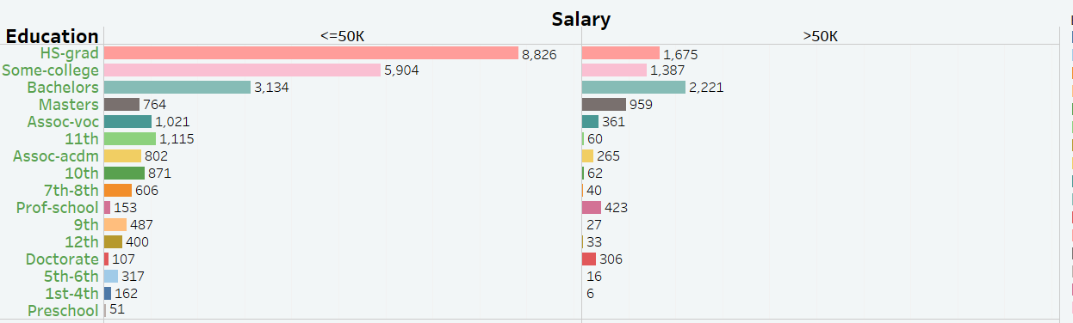
The people who have education more than 12 standard have chances to get more than 50k.

Slide 4
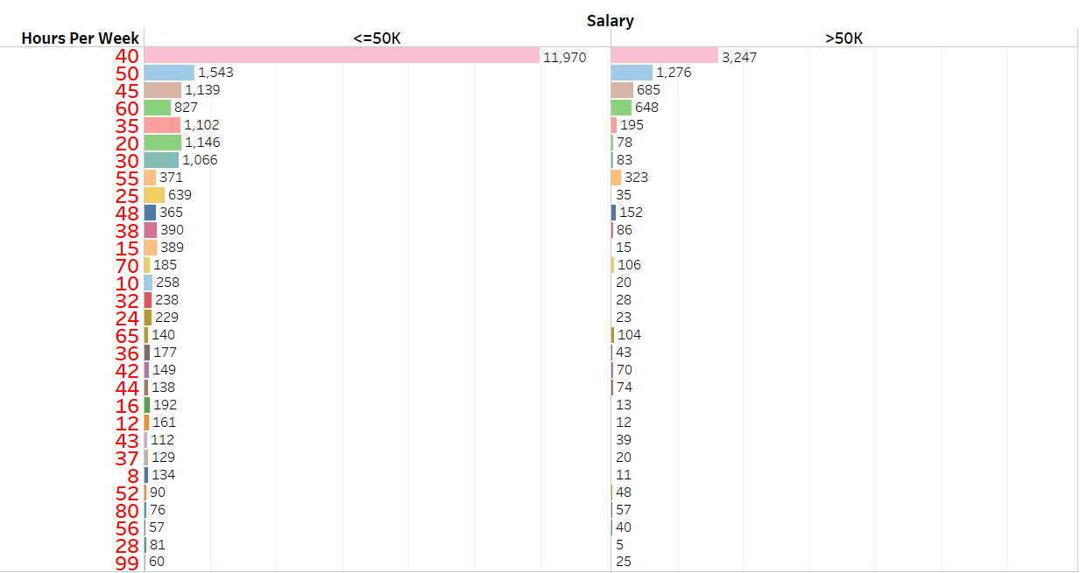
Generally people work 40 to 60 hours a week.

Slide 5
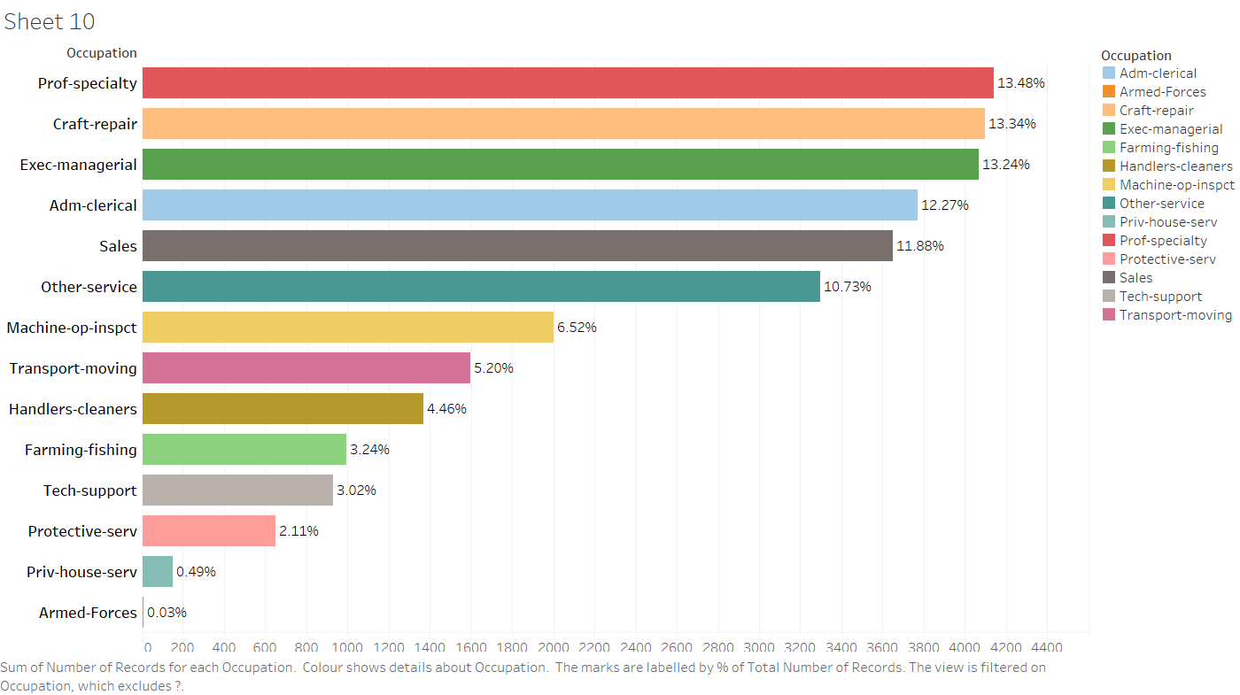
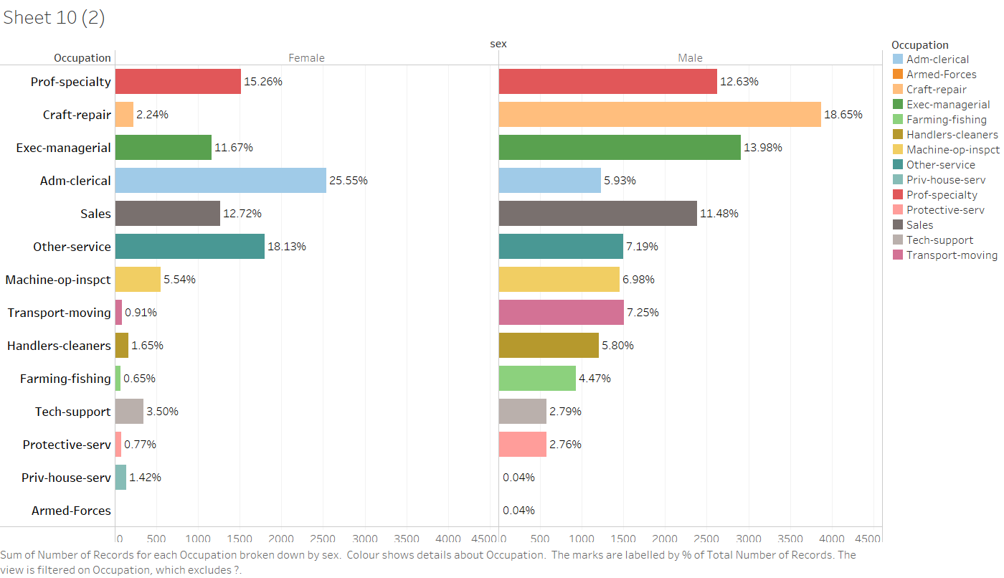
The are more people who works as a Prof-Specialty occupation.

Slide 6
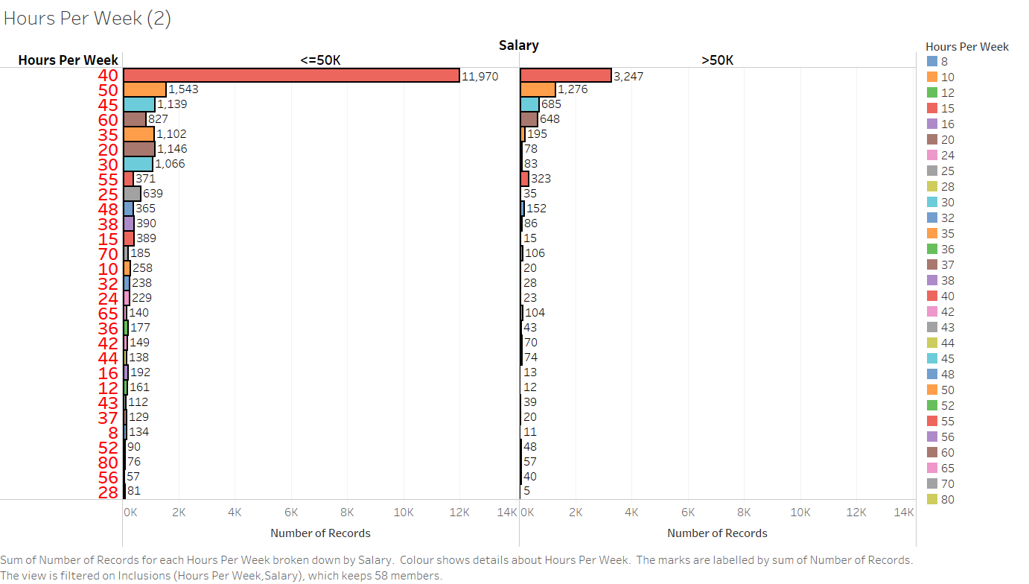
There is no direct relation in working hours.but the number of people who earn more than 50k work for 40 hours

Slide 7
Comparing all four charts the people who work as Exec-Mangerial works for more than 40hours and earns more than 50k.

Slide 8
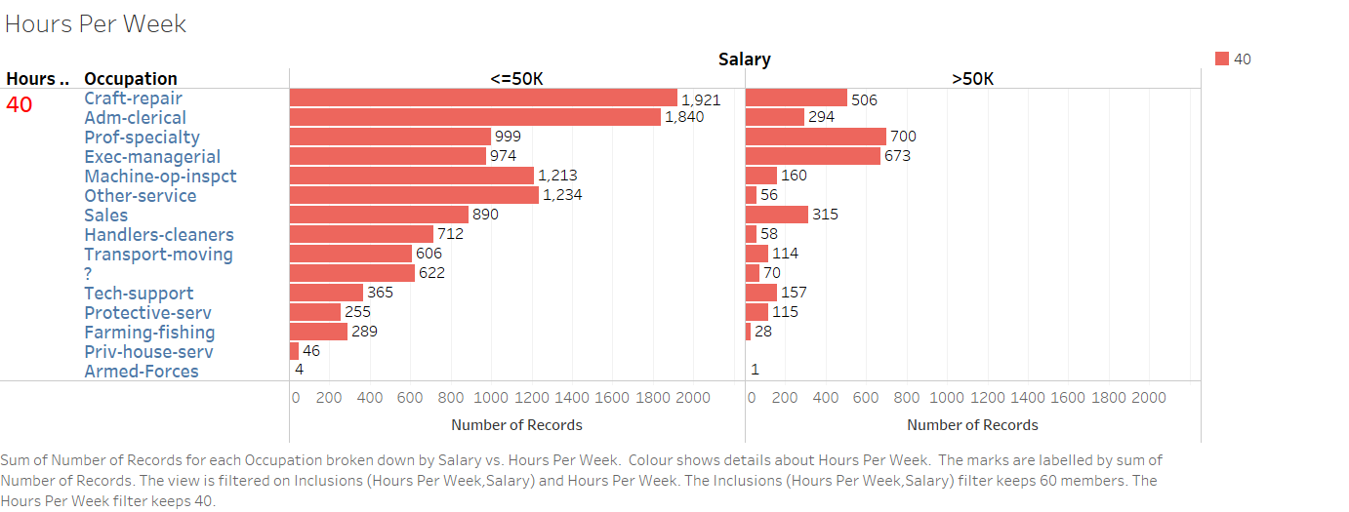
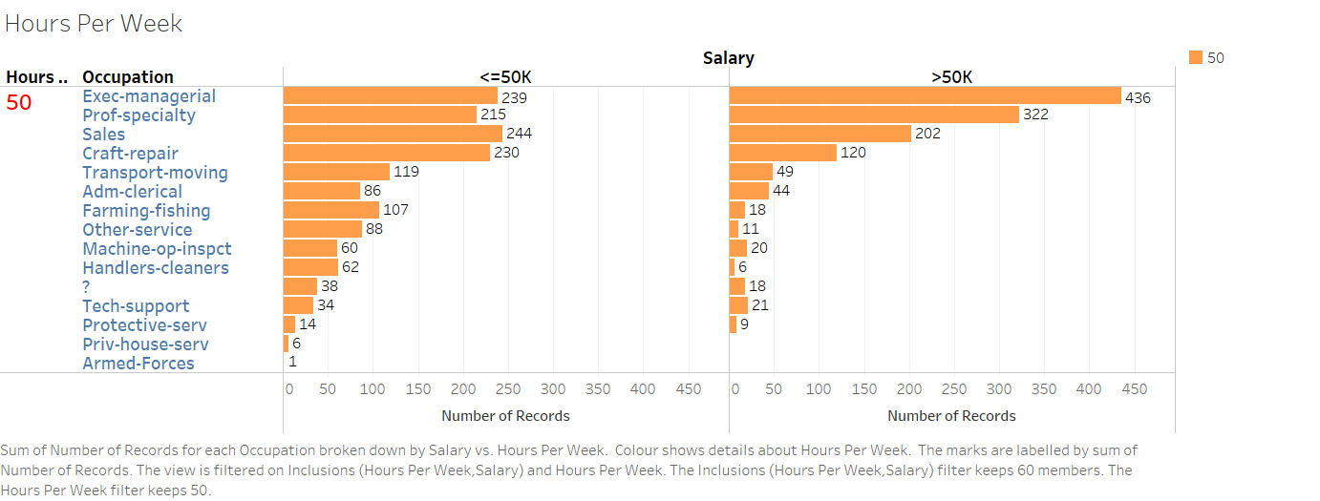
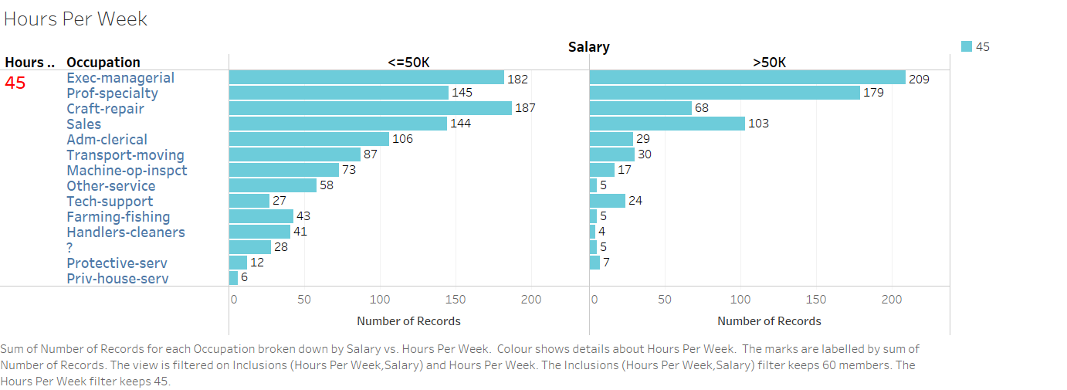
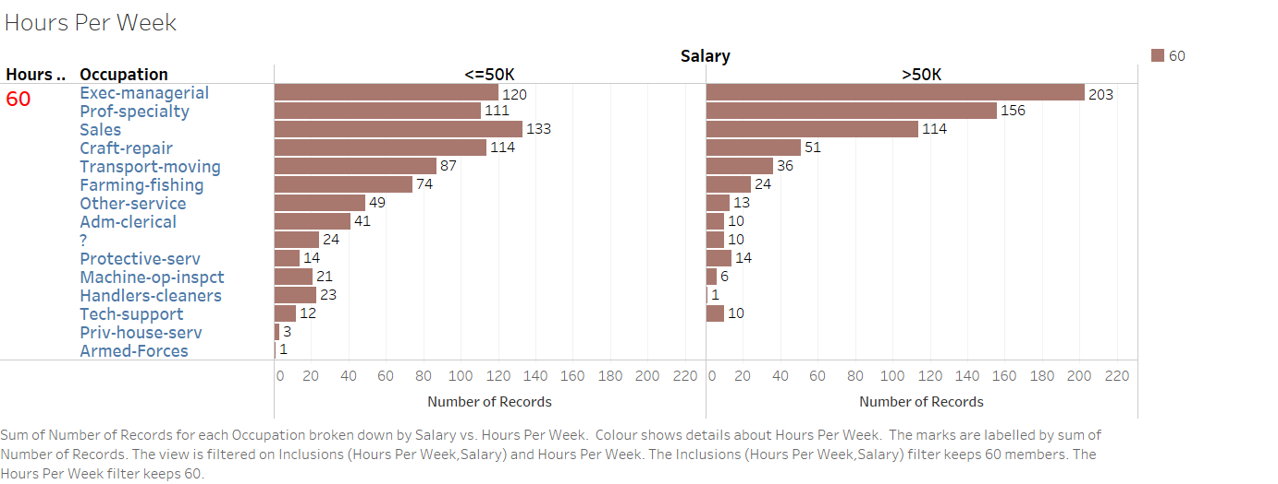

Slide 9
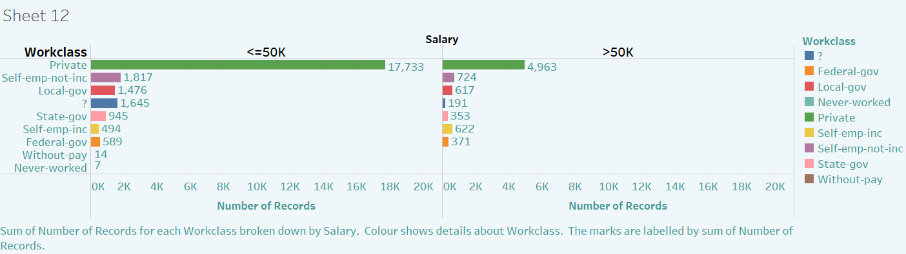
Comparing the workclass there are more people who works in a private organization earns more than 50k.

Slide 10
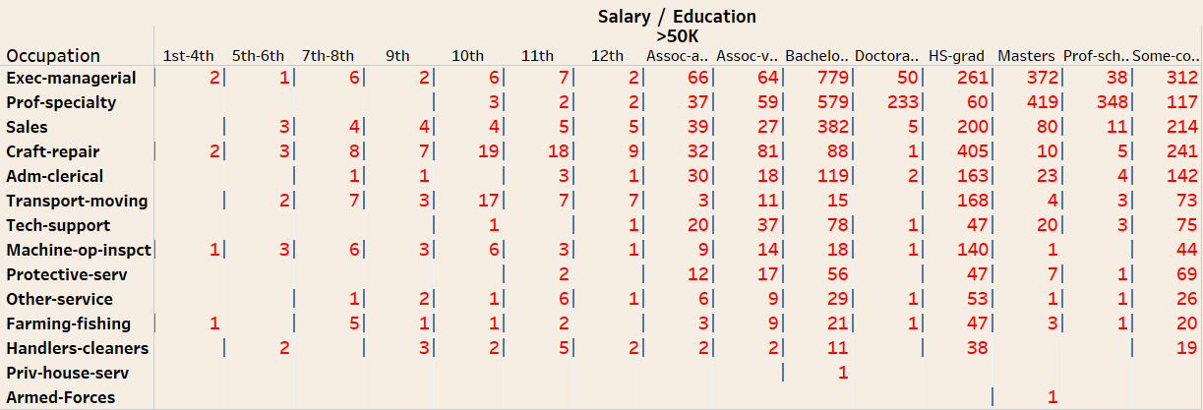
If you have your education level more than or equal to high school graduation you have more chances of earning more than 50k.

Slide 11
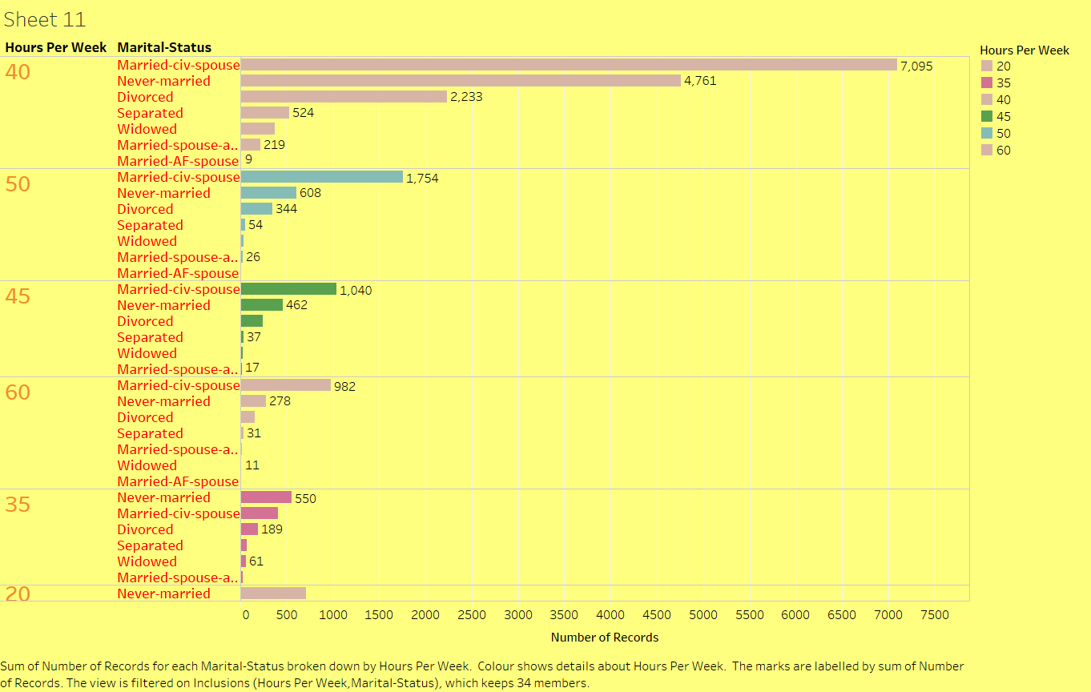
From the following chart it is observed that the people who belong to Married-civ-spouse works more.

Slide 12
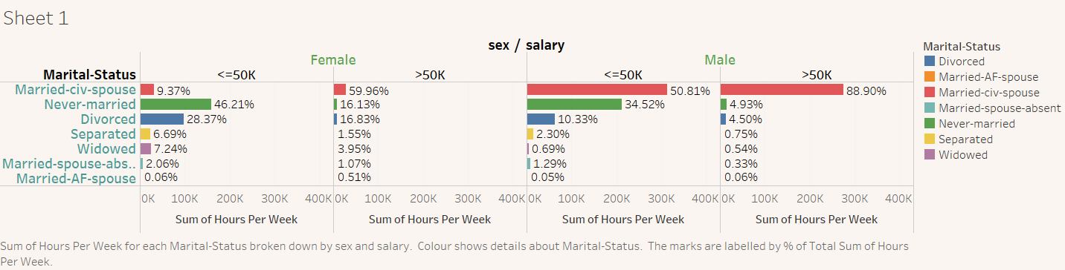
The people who have marital-status married-civ-spouse have higher percentage of earing more than 50k.

Slide 13
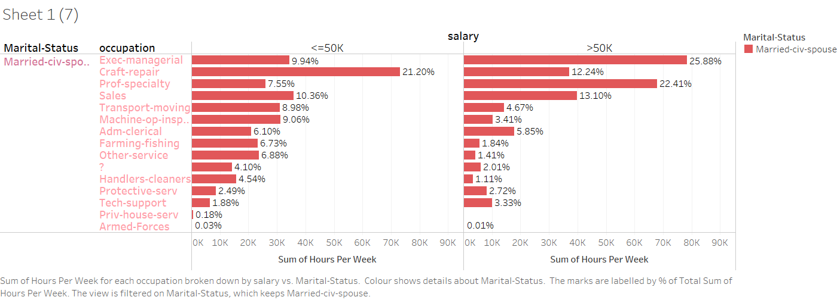
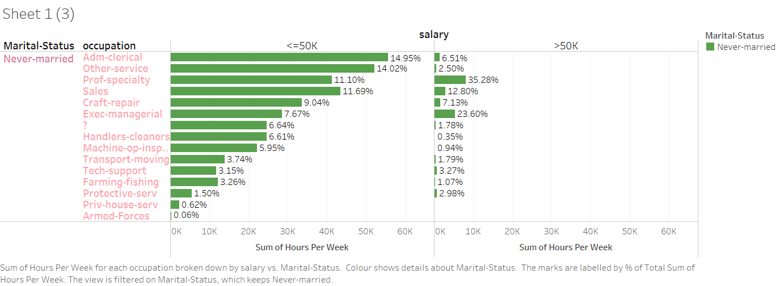
The people who are married-civ-Spouse and works as Exec-managerial have higher percentage of earning more than 50k.

